Slide 1
AN Introduction TO Cloud Computing

Slide 2

What is Cloud?
The term Cloud refers to a Network or Internet. In other words , we can say that Cloud is something, which is present at remote location.
Cloud can provide services over network, i.e, on public networks or private networks i.e, WAN, LAN.
Applications such as e-mail , web conferencing , customer relationship management (CRM) , all run in cloud.

Slide 3
What Is Cloud Computing?
Cloud computing refers to the use of hosted services, such as data storage, servers, databases, networking, and software over the internet. The data is stored on physical servers, which are maintained by a cloud service provider. Computer system resources, especially data storage and computing power, are available on-demand, without direct management by the user in cloud computing.

Slide 4
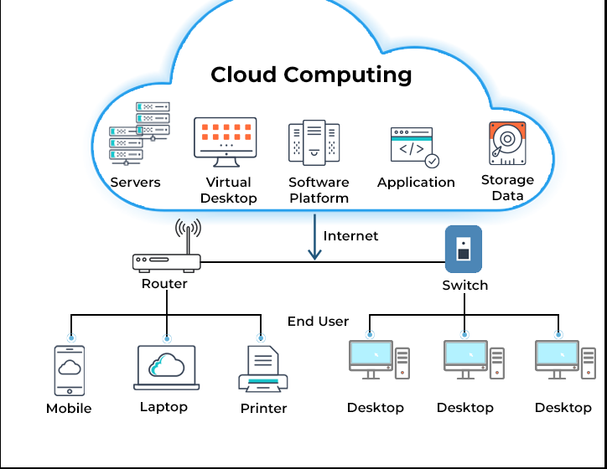
Cloud Computing Architecture

Slide 5
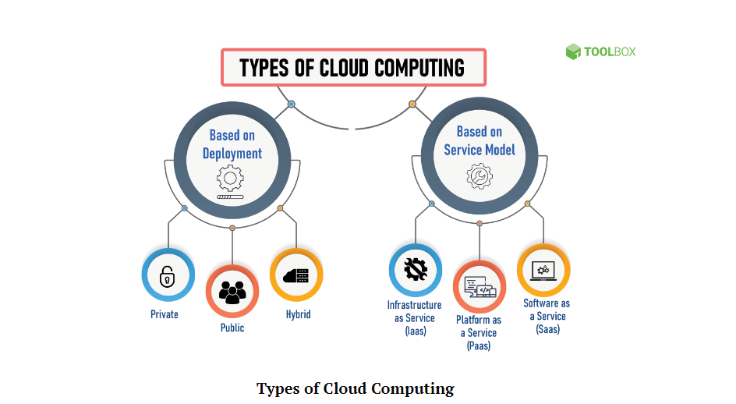

Slide 6
Private cloud
In a private cloud, the computing services are offered over a private IT network for the dedicated use of a single organization. Also termed internal, enterprise, or corporate cloud, a private cloud is usually managed via internal resources and is not accessible to anyone outside the organization.
Private clouds provide a higher level of security through company firewalls and internal hosting to ensure that an organization’s sensitive data is not accessible to third-party providers. The drawback of private cloud, however, is that the organization becomes responsible for all the management and maintenance of the data centers, which can prove to be quite resource-intensive.

Slide 7
Public Cloud
Public cloud refers to computing services offered by third-party providers over the internet. Unlike private cloud, the services on public cloud are available to anyone who wants to use or purchase them.
Public cloud can help businesses save on purchasing, managing, and maintaining on-premises infrastructure since the cloud service provider is responsible for managing the system.

Slide 8
Hybrid Cloud
Hybrid cloud uses a combination of public and private cloud features. The “best of both worlds” cloud model allows a shift of workloads between private and public clouds as the computing and cost requirements change.
In a hybrid cloud model, companies only pay for the resources they use temporarily instead of purchasing and maintaining resources that may not be used for an extended period. In short, a hybrid cloud offers the benefits of a public cloud without its security risks.

Slide 9
IaaS
Infrastructure as a service or IaaS is a type of cloud computing in which a service provider is responsible for providing servers, storage, and networking over a virtual interface. In this service, the user doesn’t need to manage the cloud infrastructure but has control over the storage, operating systems, and deployed applications.

Slide 10
PaaS
Platform as a service or PaaS is a type of cloud computing that provides a development and deployment environment in cloud that allows users to develop and run applications without the complexity of building or maintaining the infrastructure. It provides users with resources to develop cloud-based applications. In this type of service, a user purchases the resources from a vendor on a pay-as-you-go basis and can access them over a secure connection.

Slide 11
SaaS
SaaS or software as a service allows users to access a vendor’s software on cloud on a subscription basis. In this type of cloud computing, users don’t need to install or download applications on their local devices. Instead, the applications are located on a remote cloud network that can be directly accessed through the web or an API.

Slide 12
Key Benefits
Reduce Cost : Cloud providers work on the pay-as-you-go model, which means businesses only pay for the services they use, further reducing costs.
Scalability: Cloud allows organizations to grow their users from merely a few to thousands in a very short time.
Flexibility and collaboration: Since the data on cloud can be accessed directly via the internet, it gives employees the ability to work from anywhere, anytime. Cloud gives you the freedom to set up your virtual office anywhere you are.
Business continuity: Cloud safely stores and protects your data in the event of an outage or crisis. This makes it easier to resume work once the systems are up and running again.
Competitive edge: Cloud takes care of various business aspects, such as maintaining the IT infrastructure, licensing software, or training personnel to manage your data.

Slide 13
Challenges
Downtime: At times, cloud service providers may get overwhelmed due to the huge number of clients they provide services to each day. This may lead to technical outages, due to which your applications may temporarily experience some downtime.
Internet connection dependency: A user may not be able to access the data on cloud without a good internet connection and a compatible device.
Financial commitment: Cloud providers use a pay-as-you-go pricing model. However, businesses need to give a monthly or annual financial commitment for most subscription plans.
Security risks: Even if your cloud service provider promises you that they have the most reliable security certifications, there’s always a chance of losing your data.

Slide 14
TATA TO ALL
BY
Debanjan Mitra

